Slide 1

Welcome to the Presentation

Slide 2

Project on AI Applying Machine Learning to learn Knowledge from
“Diamond Price Prediction Datasets”

Slide 3

Submitted To: Redwan Ahmed Rizvee
Lecturer
Department of CSE
Submitted By: Group 2
Name | ID
Ratul Saha | 2020-1-60-036
Md. Sultan Moheuddin | 2020-1-60-043
Mahmuda Islam Rodela | 2020-2-60-038

Slide 4
Problem Description
We took a dataset named “Diamonds” from Kaggle to predict the price of a diamond based on other descriptions in the dataset column. We have a total of 10 columns and more than 50 thousand rows. Then we processed the dataset to apply machine learning models to it. We tested the model using three different models and showed the outputs.

Slide 5
Abstract
The project is to develop a model to analyze a dataset based on some model of machine learning. To get good results from the dataset, we need to modify data by considering data preprocessing, feature selection, choosing classification algorithms, and analyzing their performance.

Slide 6
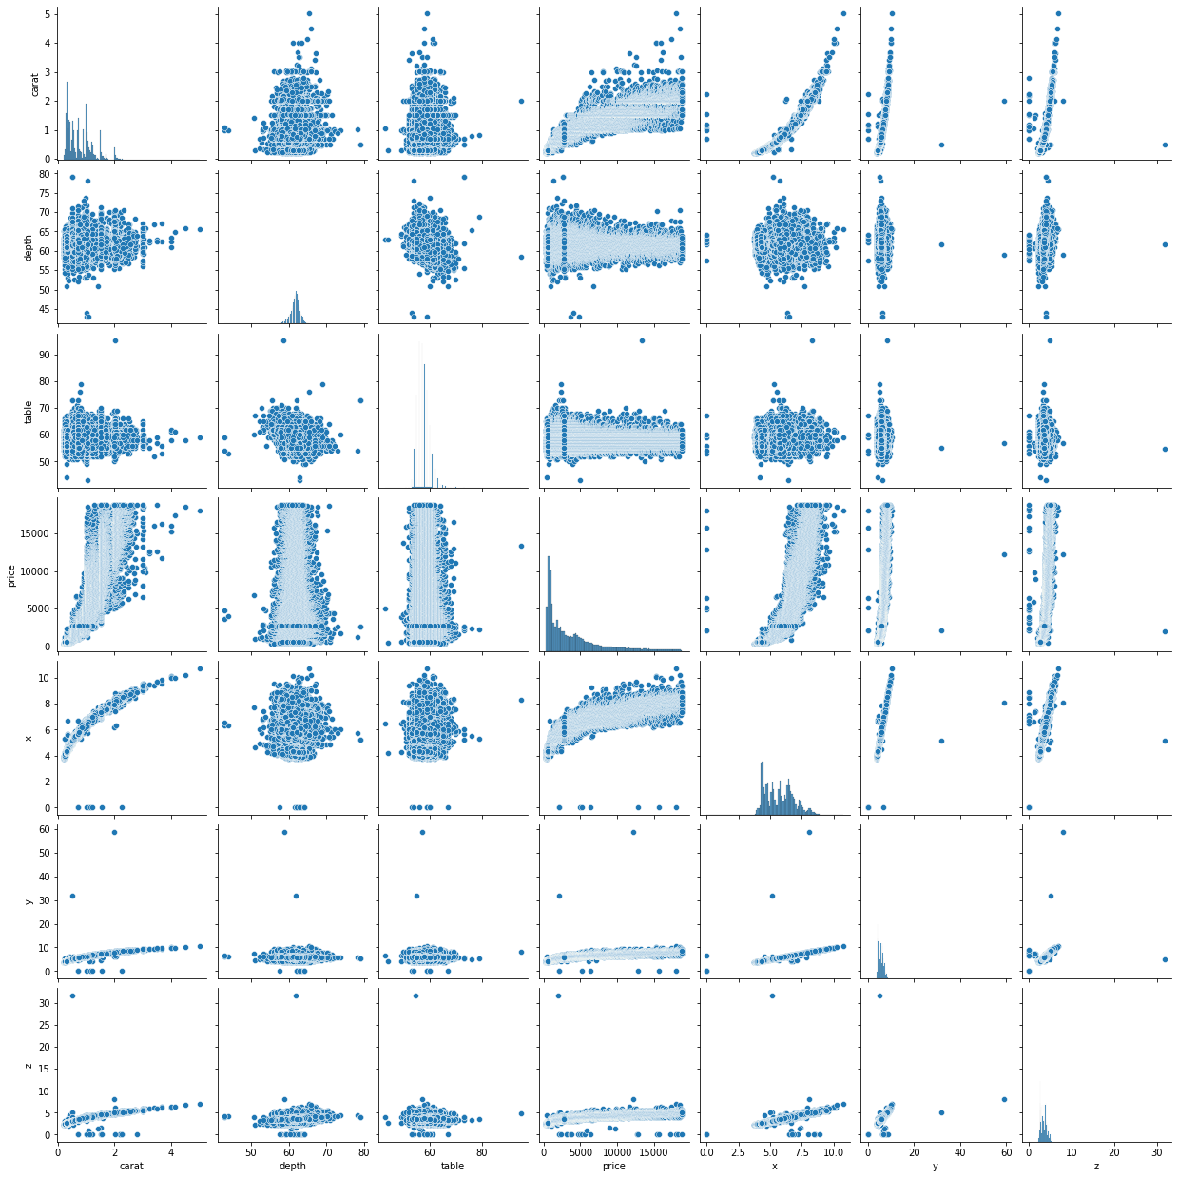
Data Pre-Processing (Scatter_plot)
Though there were no null values, some of the values were 0(zero). So, firstly we replaced those values with “null”.
We found a huge number of outliers and dropped them from the dataset

Slide 7
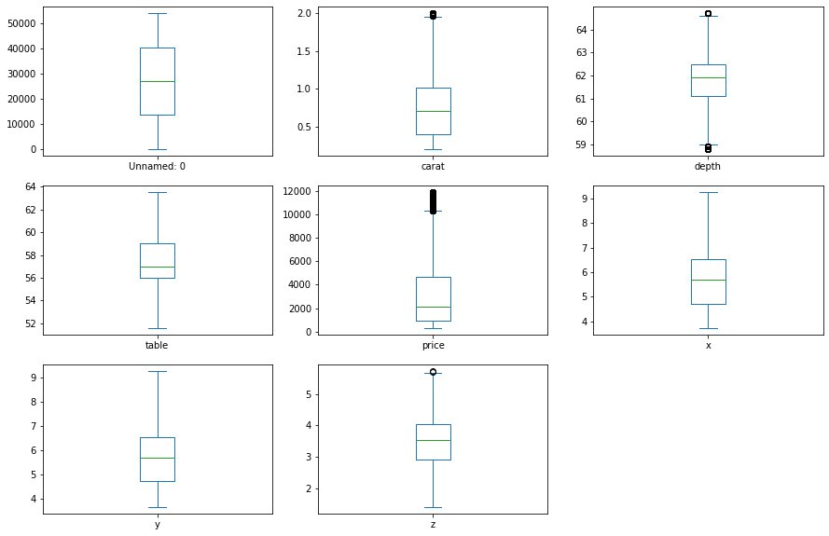
Data Pre-Processing (Box_plot)
Then we found some null values from the columns (carat, price and depth) and replaced them with mean and median.
We saw, the distributions are quite normal, but the price is a little bit biased. So, we replaced null values of price by median and the rest two are replaced by mean value.

Slide 8
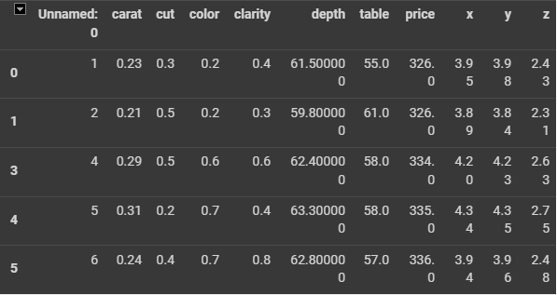
Data Pre-Processing (Transform_value)
We transformed them to numeric values by replacing them with data.replace({:}) function.

Slide 9
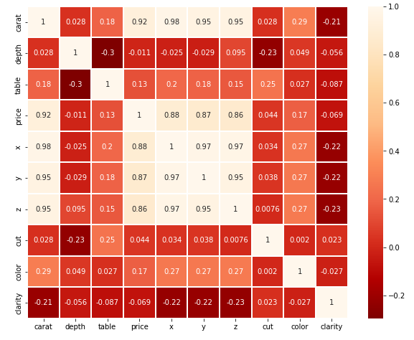
Correlation Matrix
We can see that there is a good relationship between price and other columns, we can say, our data pre-processing or cleaning is almost done. It is now ready to split in test and train cases.

Slide 10
Applying Machine Learning Algorithm
We trained 80% data to train our model and kept the remaining 20% data to test the model’s performance.
Among all those, some works for categorical and some works better on numeric variables. So, we applied 3 different algorithms on the dataset and those are
1. Decision tree
2. Naive Bayes algorithm
3. Random forest algorithm

Slide 11
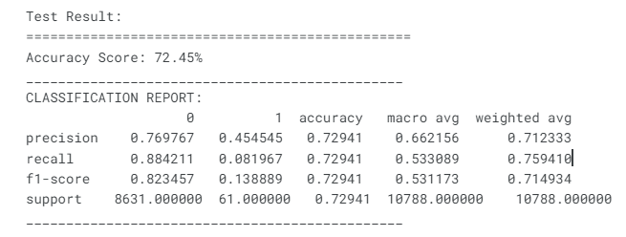
Decision Tree Algorithm
It works well in classifying both categorical and continuous dependent variables. As our dataset category matches with its classification, we applied this in our dataset and got 72.45% accuracy.

Slide 12
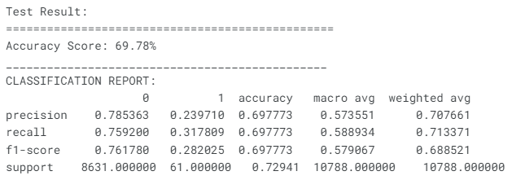
Naive Bayes Algorithm
A Naive Bayesian model is easy to build and useful for massive datasets. It's simple and is known to outperform even highly sophisticated classification methods. As we are working on a massive dataset, this algorithm is one of the essential ones to use.

Slide 13
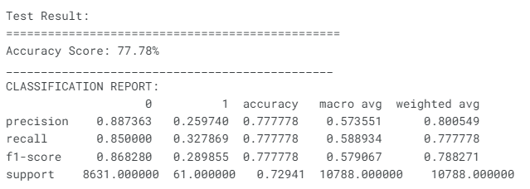
Random Forest Algorithm
We used a decision tree algorithm on our model and sometimes that model shows results in a biased way. To know the accuracy in a more precise way, we implemented a random forest algorithm.

Slide 14
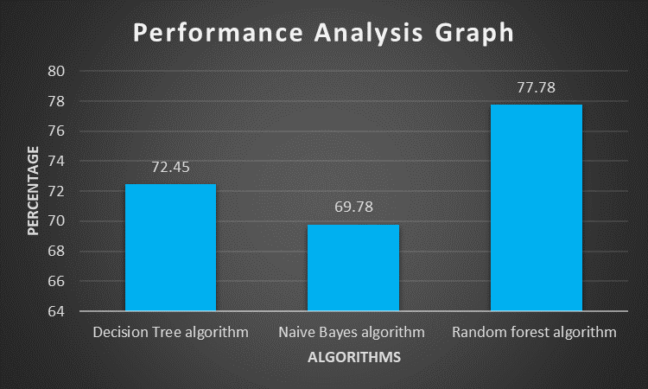
Performance Analysis Graph

Slide 15
Conclusion
That was a great experience for us while working on a dataset using AI and machine learning. The journey was started from selecting a suitable dataset and ends with a formal visualization using different models on it. We got quite satisfactory results on the dataset applying different algorithms. We have tried several ways to ensure the best results. Most importantly, we have learned several things along the way

Slide 16

Thank You

